Slide 1
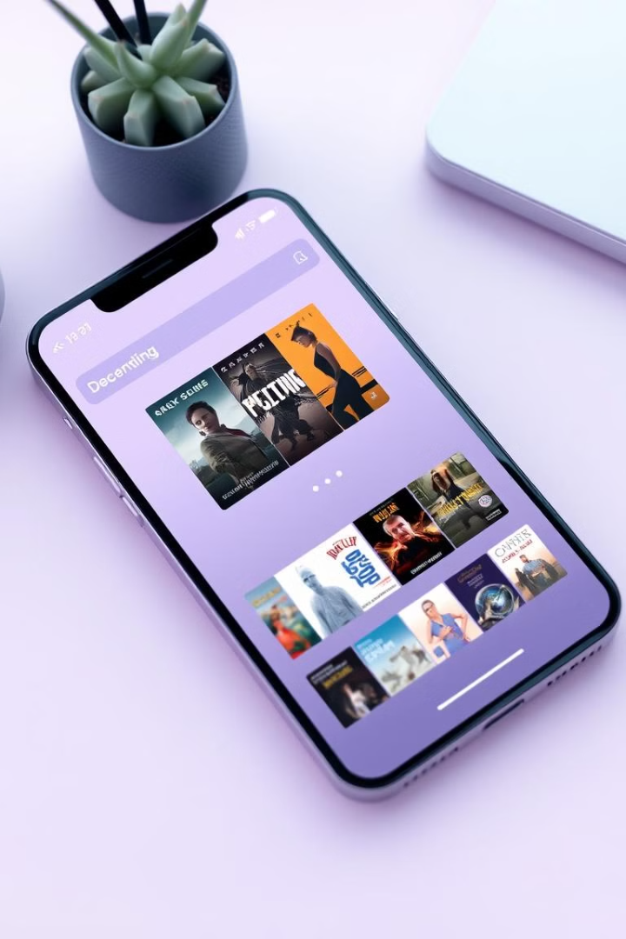

Weflix: The Netflix Clone
Weflix is a comprehensive Netflix clone, designed to deliver a seamless and immersive streaming experience. This presentation will provide a detailed overview of the project, including the technology stack, design and planning, key features, and future enhancements.
by jayeshnik

Slide 2
Technology Stack
Frontend
The Weflix frontend is built using React.js, offering a responsive and dynamic user interface.
HTML and CSS are utilized to structure and style the web pages, ensuring a visually appealing and consistent design.

Slide 3
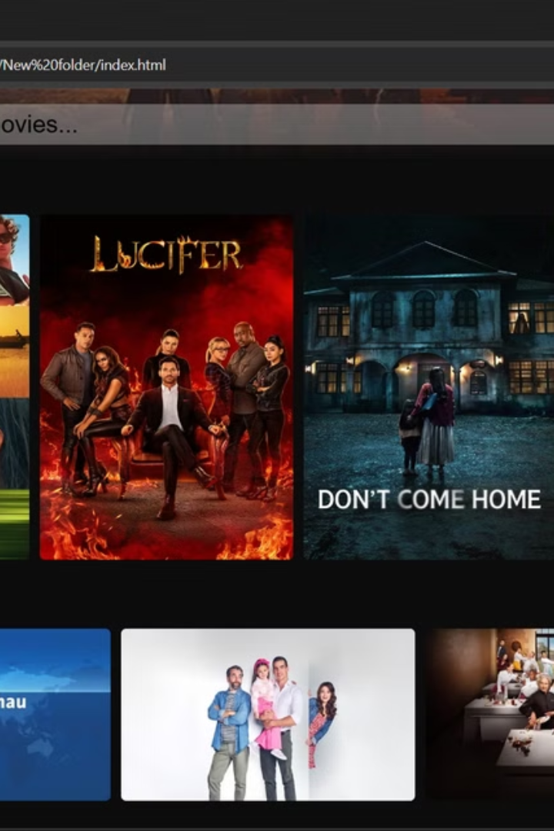
Design and Planning
1
Platform Objectives
2
UI/UX Design
The primary objectives for the Weflix platform include providing a seamless streaming experience, personalized recommendations, and a user-friendly interface.
The design process involves creating intuitive and visually appealing user interfaces, with a focus on enhancing the overall user experience.

Slide 4

Use Case Diagram
User Login
Users can create an account and log in to the Weflix platform, accessing personalized recommendations and content.
Playlist Management
Users can create and manage their own playlists, saving their favorite content for easy access.
1
2
3
4
View movies/series
browse home page
Users can explore the vast library of movies, TV shows, and documentaries.
searching for movies and exploring catagories

Slide 5

Key Features
Extensive Content Library
Personalized Recommendations
Weflix offers a vast and diverse collection of movies, TV shows, and documentaries, catering to a wide range of user preferences.
The platform utilizes advanced algorithms to provide personalized content recommendations based on user viewing history and preferences.
Social Sharing
Offline Viewing
Users can share their favorite content with friends and family, fostering a sense of community and discovery.
Weflix allows users to download content for offline viewing, ensuring seamless entertainment even in areas with limited internet access.

Slide 6




Future Enhancements
4K Streaming
AI-Driven Recommendations
VR Integration
Weflix aims to incorporate 4K video streaming capabilities, delivering an even more immersive and high-quality viewing experience.
Leveraging the power of artificial intelligence, Weflix will continue to refine its personalized recommendation system, providing increasingly accurate and relevant content suggestions.
Weflix is exploring the integration of virtual reality (VR) technology, allowing users to enjoy a more immersive and interactive streaming experience.

Slide 7

Conclusion
Weflix is a comprehensive Netflix clone that aims to provide a seamless and engaging streaming experience. With its robust technology stack, thoughtful design, and innovative features, Weflix is poised to become a leading player in the competitive video streaming landscape.

Slide 8
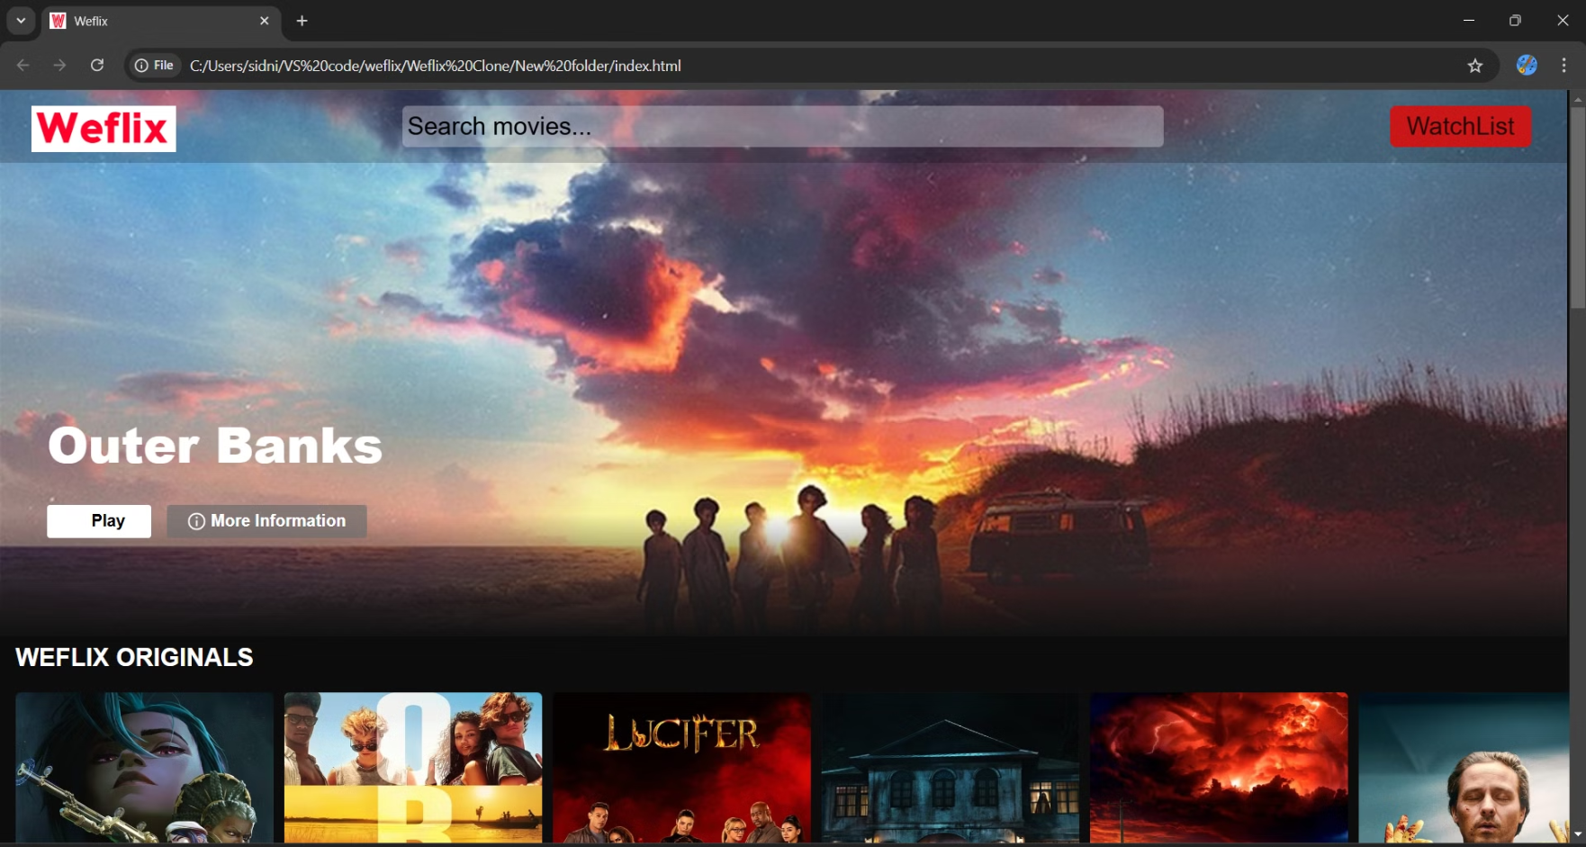
Weflix Interface

Slide 9
Thank You!
Thank you for your time and attention. We hope this presentation has provided you with valuable insights into Weflix. We would love to hear your thoughts and answer any questions you may have.
Contact us at: [jayeshnik851@gmail.com]/
number: 9739273876

